Slide 1
How to use Sign-it! signature saver for (Android Devices 7.0 or lower)
Sally Newcomb

Slide 2
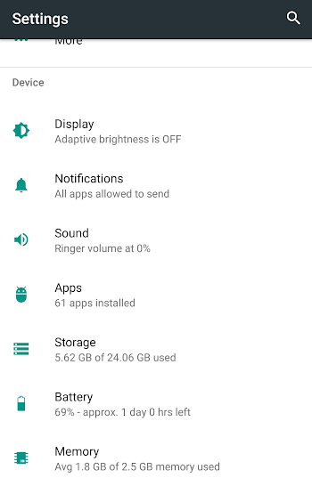
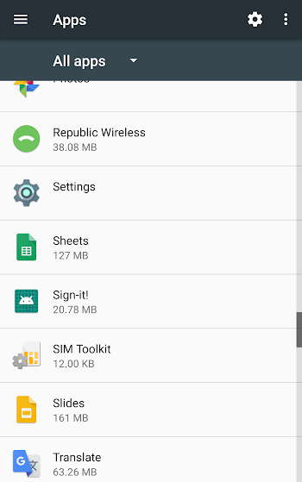
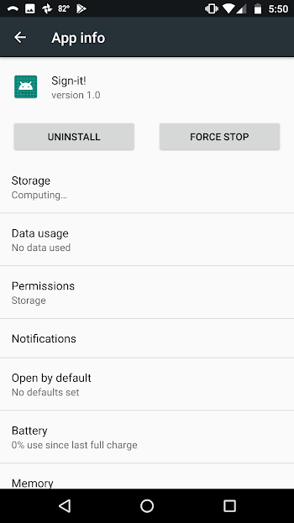

Step 1: App Permissions
Under the heading “Device” select Apps
Scroll down and select Sign-it!
Select the category permissions
Slide the switch if it is not already green.

Slide 3
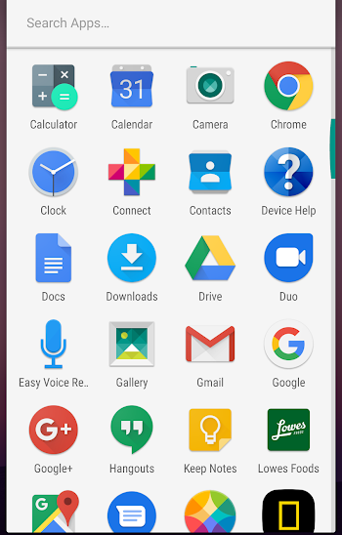
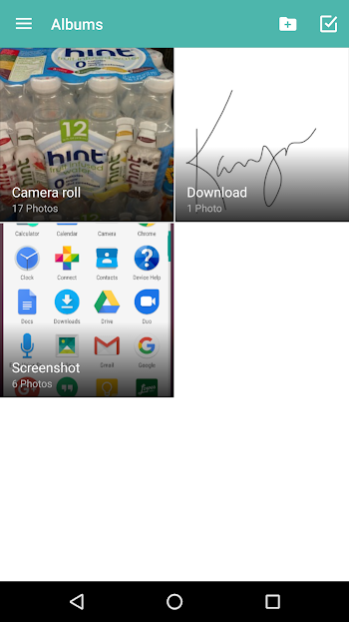
Step 2: Accessing Saved Photos
To access your saved signatures go to the Gallery app.
The image will be in an album called Download

Slide 4
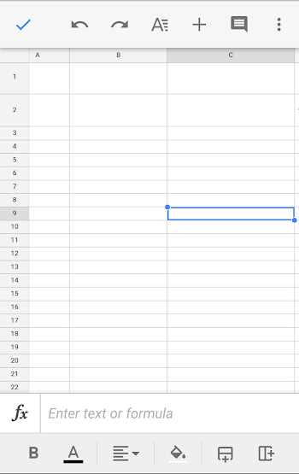
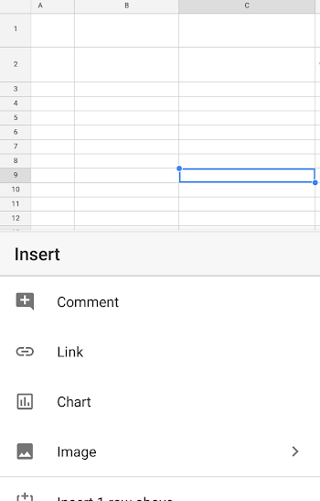
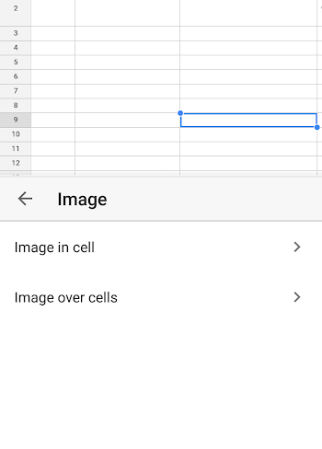
Step 3: Putting the signature is Google Sheets
First, select the box that you want to add a signature to and press the plus sign in the top right corner.
Then, select “Image” in the insert menu.
Next, click “ Image in cell,” this will keep whatever image you select within the cell boundaries.

Slide 5
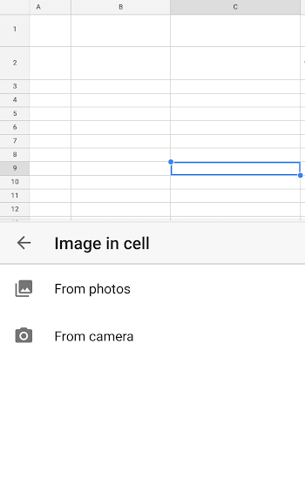
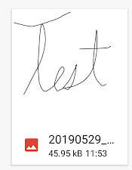
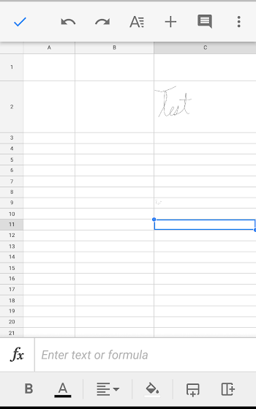
Step 3 Continued
Select “From photos.”
Select the signature from the downloads section of the photo directory.
And now the photo is inserted into the google sheets document.

